Slide 1
EN 410 Energy Management
Gurubalan Annadurai
guru.a@iitb.ac.in

Slide 2
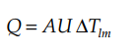
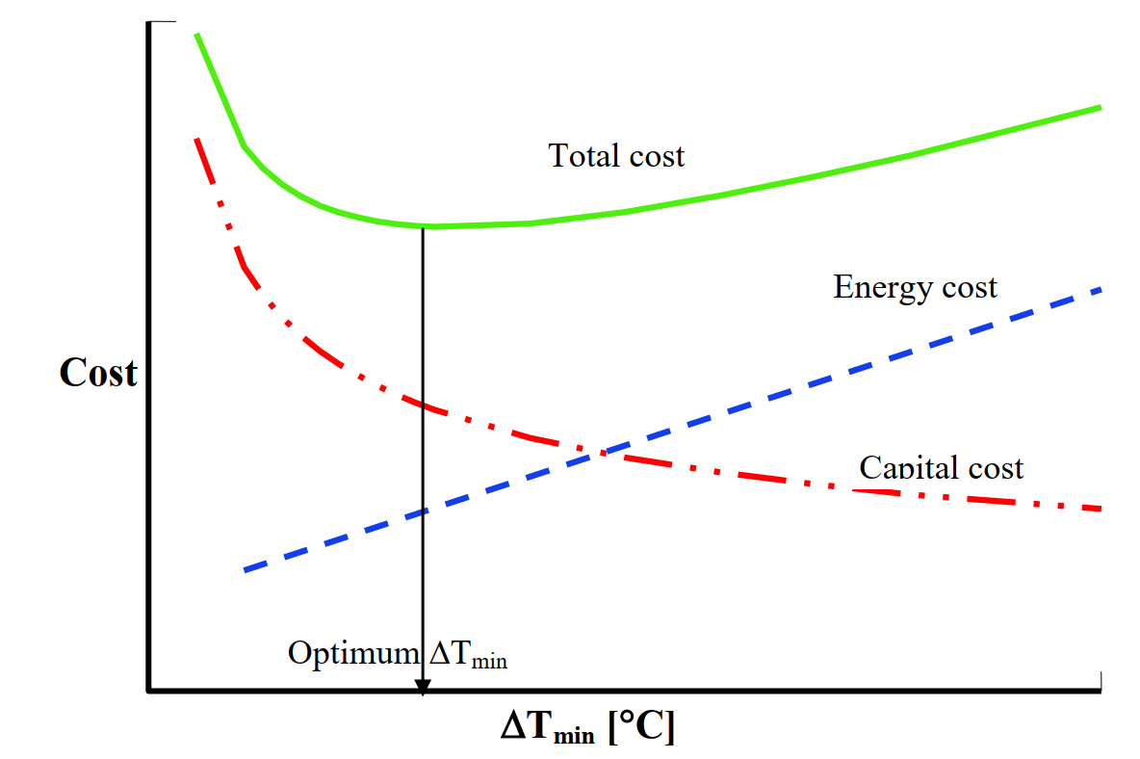
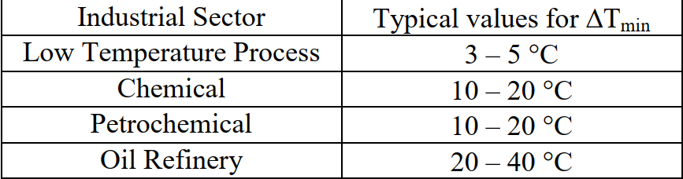
Minimum temperature difference
Higher the ΔT lesser the area, lesser the heat recovery, larger the external utilities
Vice versa

Slide 3
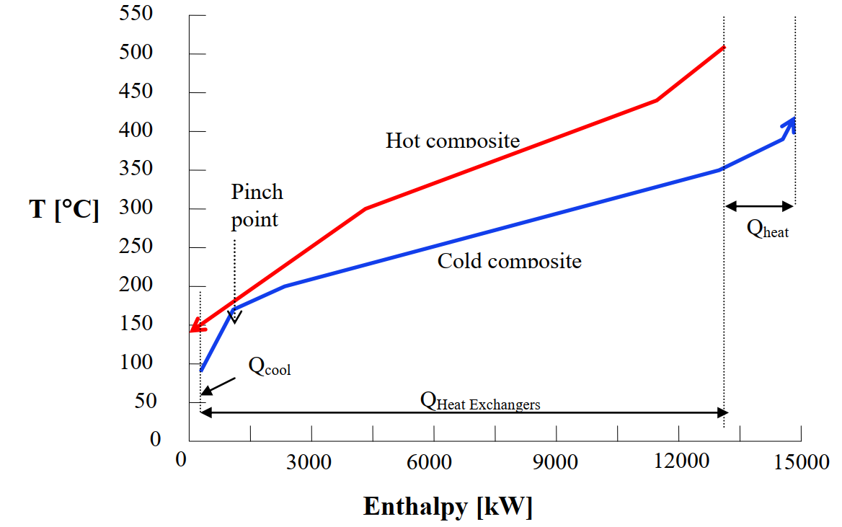
Composite curve for hot and cold streams
No heat transfer across pinch, otherwise the system needs more external utilities than the thermodynamic minimum

Slide 4
Problem table approach
ΔT_{min} = 10℃
Divide among the streams or
Increase the cold stream temperature or
Decrease the hot stream temperature
1. Estimate the new temp of streams
 | Process stream type | Inlet temp | Outlet temp | Heat capacity rate | Q
 | - | ℃ | ℃ | kW/K | kW
1 | Cold | 90 | 420 | 10 | 3300
2 | Cold | 170 | 350 | 32 | 5760
3 | Cold | 200 | 390 | 29 | 5510
4 | Hot | 440 | 140 | 27 | 8100
5 | Hot | 510 | 300 | 24 | 5040
 | Process stream type | Inlet temp | Outlet temp | Heat capacity rate
 | - | ℃ | ℃ | kW/K
1 | Cold | 90 | 420 | 10
2 | Cold | 170 | 350 | 32
3 | Cold | 200 | 390 | 29
4 | Hot | 430 | 130 | 27
5 | Hot | 500 | 290 | 24

Slide 5
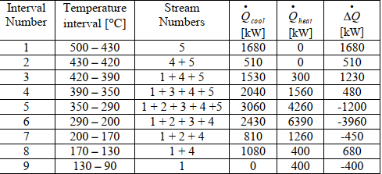
Problem table approach
2. Estimate the new temp intervals and Q

Slide 6
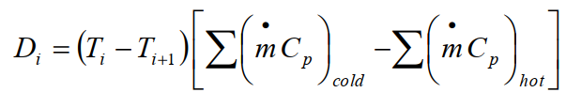
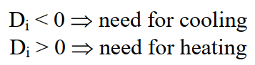
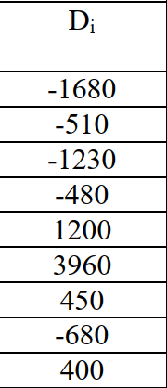
Estimate the energy availability
3. Estimate the excess energy in each interval
 | Process stream type | Heat capacity rate
 | - | kW/K
1 | Cold | 10
2 | Cold | 32
3 | Cold | 29
4 | Hot | 27
5 | Hot | 24

Slide 7
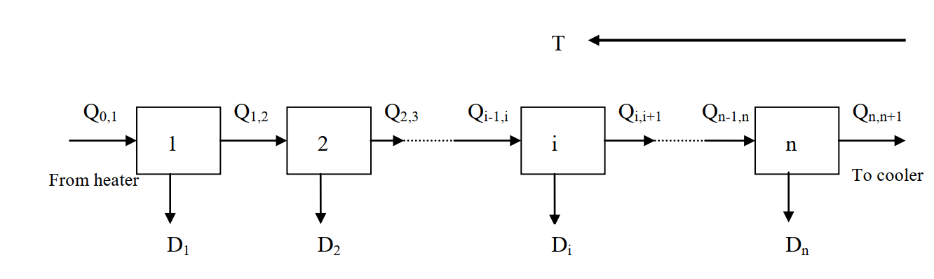
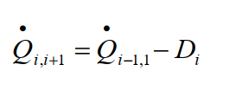
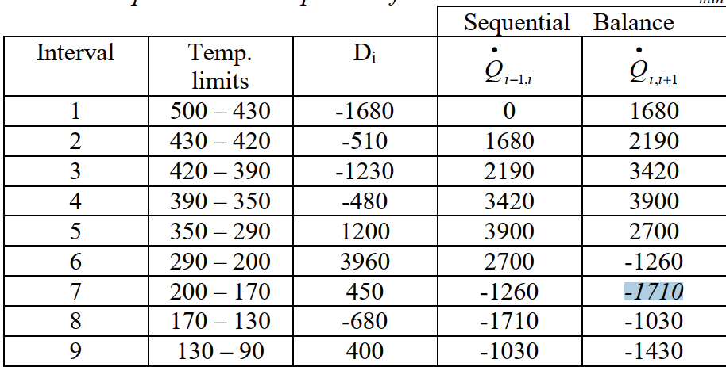
Estimate the sequential balance
4. Estimate the supplied heat to the each interval
Minimum utility load which must be added to the network to avoid any deficit at lower intervals

Slide 8
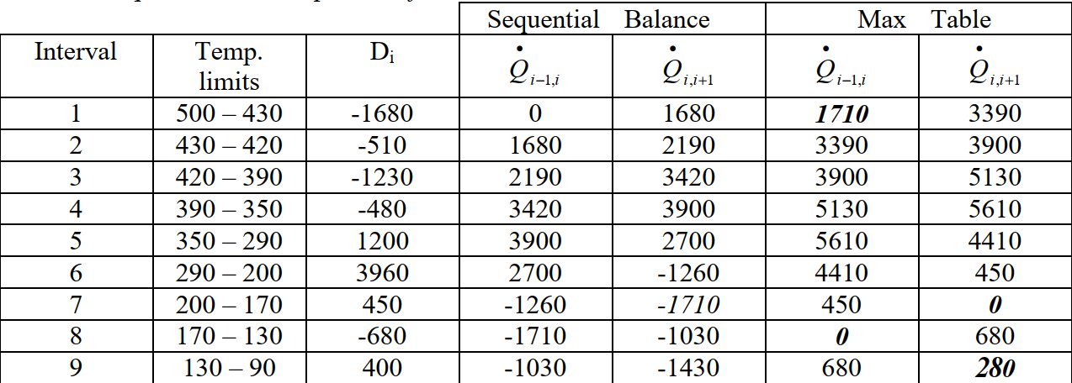
Problem table approach
5. Estimate the new supplied heat to the each interval, 1710 kW as load input in the interval 1
Pinch temperature = 170℃ (for cold= = 170℃ , hot = 180℃)
Minimum heating utility = 1710 kW
Minimum cooling utility = 280 kW

Slide 9
Composite curve for hot and cold streams

